Slide 1
Software Requirements Engineering
By
Abid Ali
BS Software Engineering
5th
Lecture #11

Slide 2
Agenda
User classes. . . . . . . . . . . . . . . . . . . . . . . . . . . .
Classifying users. . . . . . . . . . . . . . . . . . . . .
Identifying your user classes. . . . . . . . . . . .
User personas. . . . . . . . . . . . . . . . . . . . . . . . . . .
Connecting with user representatives. . . . . . . .

Slide 3
Classifying users
A product’s users might differ—among other ways—in the following respects, and you can group users into a number of distinct user classes based on these sorts of differences:
Their access privilege or security levels (such as ordinary user, guest user, administrator)
The tasks they perform during their business operations
The features they use

Slide 4
Cont..
The frequency with which they use the product
Their application domain experience and computer systems expertise
The platforms they will be using (desktop PCs, laptop PCs, tablets, smartphones, specialized devices)
Their native language
Whether they will interact with the system directly or indirectly

Slide 5
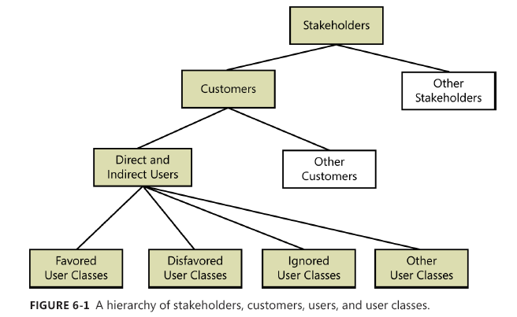
Cont..

Slide 6
Cont..
Certain user classes could be more important than others for a specific project.
Favored user classes are those whose satisfaction is most closely aligned with achieving the project’s business objectives.
Disfavored user classes are groups who aren’t supposed to use the product for legal, security, or safety reasons (Gause and Lawrence 1999).

Slide 7
Cont..
Each user class will have its own set of requirements for the tasks that members of the class must perform.
There could be some overlap between the needs of different user classes.
Tellers, business bankers, and loan officers all might have to check a bank customer’s account balance, for instance.
Different user classes also could have different quality expectations, such as usability, that will drive user interface design choices.
New or occasional users are concerned with how easy the system is to learn. Such users like menus, graphical user interfaces, uncluttered screen displays, wizards, and help screens.
As users gain experience with the system, they become more interested in efficiency.
They now value keyboard shortcuts, customization options, toolbars, and scripting facilities.

Slide 8
Identifying your user classes
Identify and characterize the different user classes for your product early in the project so you can elicit requirements from representatives of each important class.
A useful technique for this is a collaboration pattern developed by Ellen Gottesdiener called “expand then contract” (Gottesdiener 2002).
Start by asking the project sponsor who he expects to use the system. Then brainstorm as many user classes as you can think of.

Slide 9
Cont..
Various analysis models can help you identify user classes. The external entities shown outside your system on a context diagram are candidates for user classes.
A corporate organization chart can also help you discover potential users and other stakeholders (Beatty and Chen 2012).
Figure 6-2 illustrates a portion of the organization chart for Contoso Pharmaceuticals.
Nearly all of the potential users for the system are likely to be found somewhere in this chart.
While performing stakeholder and user analysis, study the organization chart to look for:

Slide 10
Cont..
Departments that participate in the business process.
Departments that are affected by the business process.
Departments or role names in which either direct or indirect users might be found.
User classes that span multiple departments.
Departments that might have an interface to external

Slide 11
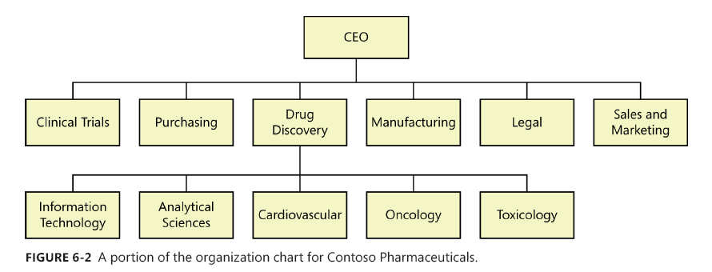
Cont..

Slide 12
Cont..
Document the user classes and their characteristics, responsibilities, and physical locations in the software requirements specification (SRS) or in a requirements plan for your project.
Check that information against any information you might already have about stakeholder profiles in the vision and scope document to avoid conflicts and duplication.
Include all pertinent information you have about each user class, such as its relative or absolute size and which classes are favored.
This will help the team prioritize change requests and conduct impact assessments later on.
Estimates of the volume and type of system transactions help the testers develop a usage profile for the system so that they can plan their verification activities.
The project manager and business analyst of the Chemical Tracking System discussed in earlier chapters identified the user classes and characteristics shown in Table 6-1.

Slide 13
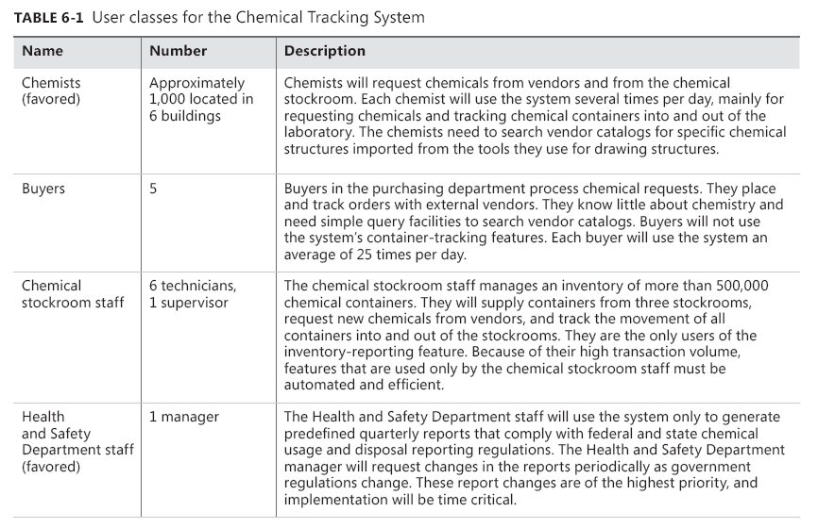
Cont..

Slide 14
User personas
To help bring your user classes to life, consider creating a persona for each one, a description of a representative member of the user class (Cooper 2004; Leffingwell 2011).
A persona is a description of a hypothetical, generic person who serves as a stand-in for a group of users having similar characteristics and needs.
You can use personas to help you understand the requirements and to design the user experience to best meet the needs of specific user communities.

Slide 15
Connecting with user representatives
Every kind of project—corporate information systems, commercial applications, embedded systems, websites, contracted software—needs suitable representatives to provide the voice of the user.
These users should be involved throughout the development life cycle, not just in an isolated requirements phase at the beginning of the project.
Each user class needs someone to speak for it.

Slide 16
Cont..
Figure 6-3 illustrates some typical communication pathways that connect the voice of the user to the ear of the developer.
One study indicated that employing more kinds of communication links and more direct links between developers and users led to more successful projects (Keil and Carmel 1995).
The most direct communication occurs when developers can talk to appropriate users themselves, which means that the developer is also performing the business analyst role.
This can work on very small projects, provided the developer involved has the appropriate BA skills, but it doesn’t scale up to large projects with thousands of potential users and dozens of developers

Slide 17
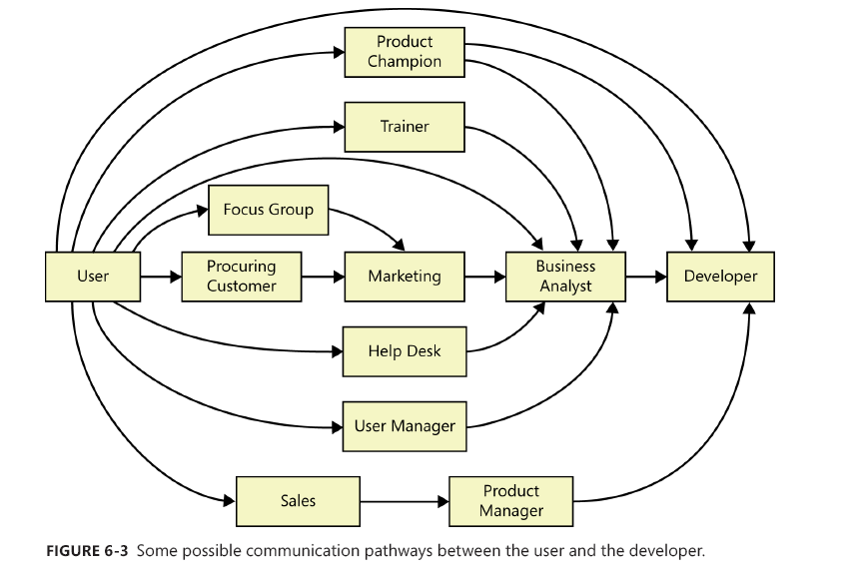
Cont..

Slide 18
15-05-2018
Section B
Section A
16-05-2018

Slide 19
The end
Thank You

